Slide 1
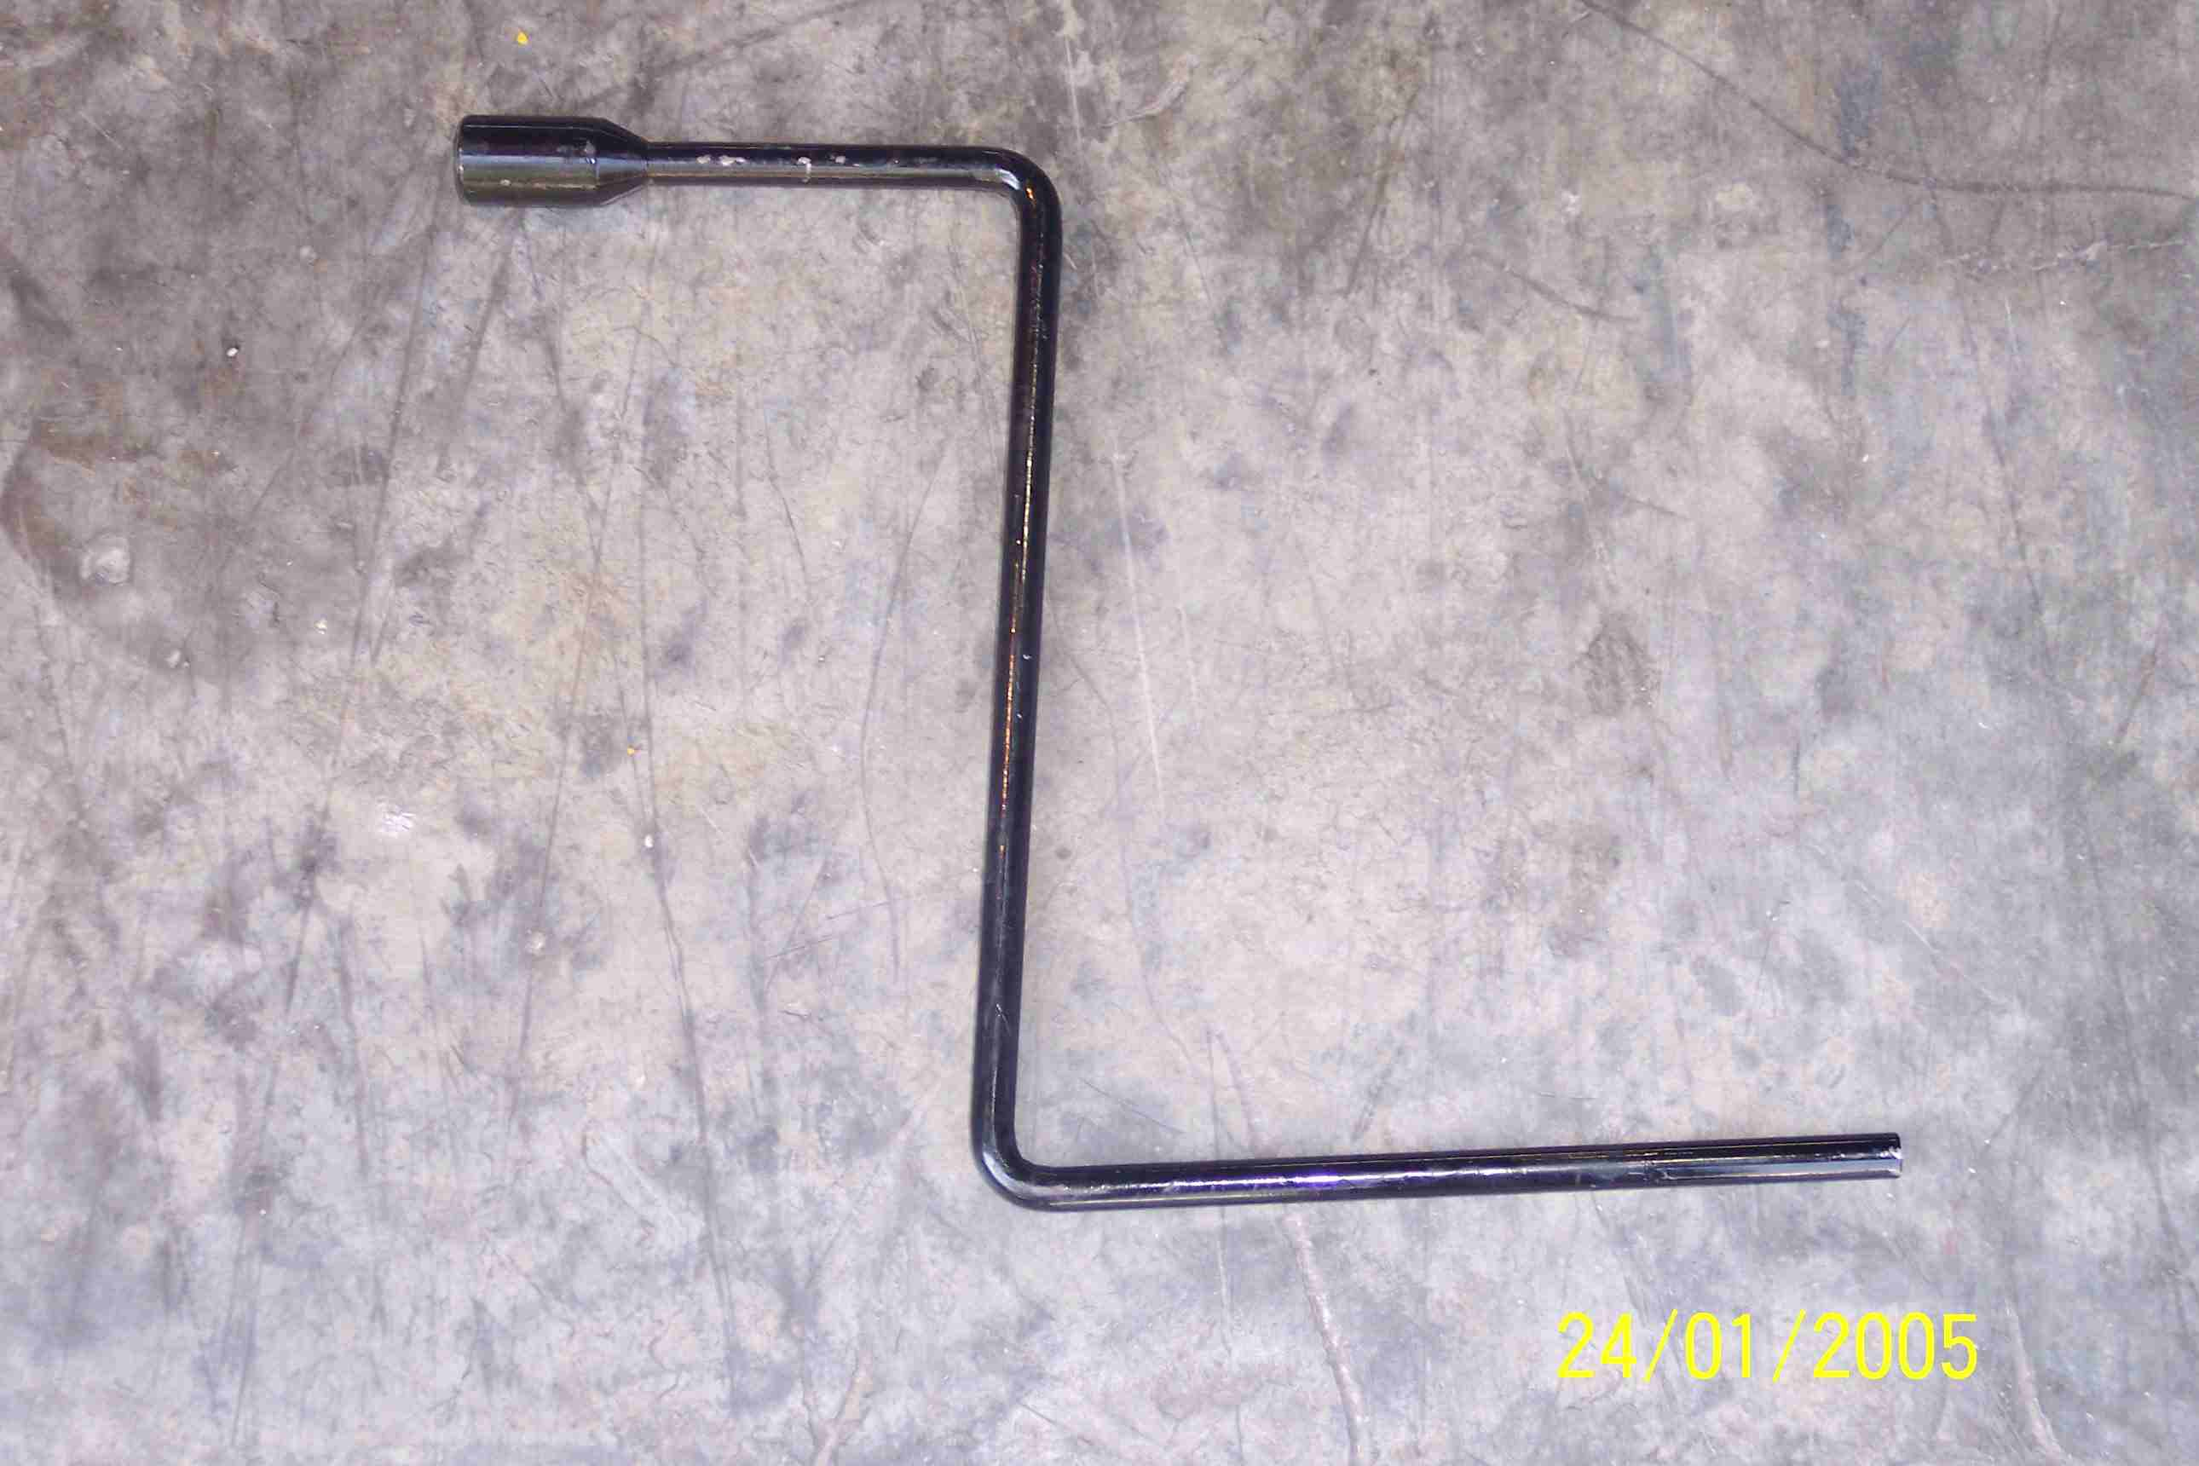
SIEMENS
HVCB SPARES
Spring Charging Handle
72.5KV, 145KV & 245KV CB
S4799056001

